Slide 1
ATA Annual Member Meeting
Reading, Weathersfield, West Windsor and Windsor
Vermont June 2023

Slide 2
2023 ATA Annual Meeting Agenda
Introduction: Board Members
Flow Trail/Park/Pump Track
Trails Updates
Hiking Activities
Planned Trailwork / Signage
Operations - Website/Communications
Youth Group
Treasurer's Report/Budget Review
Membership Recap
Event Recap
Trail Stats
Partner Organizations
Board of Director Openings

Slide 3
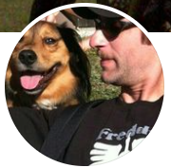
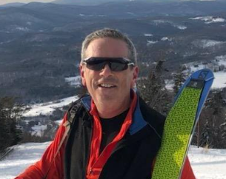
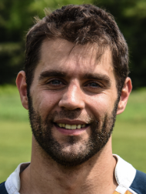
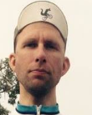
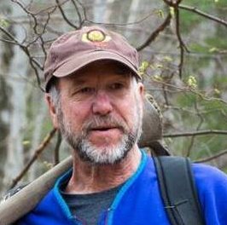
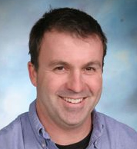
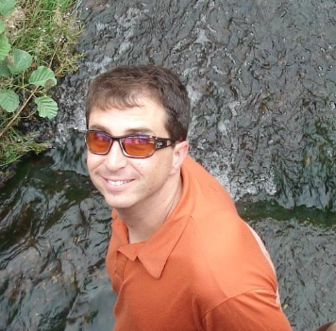
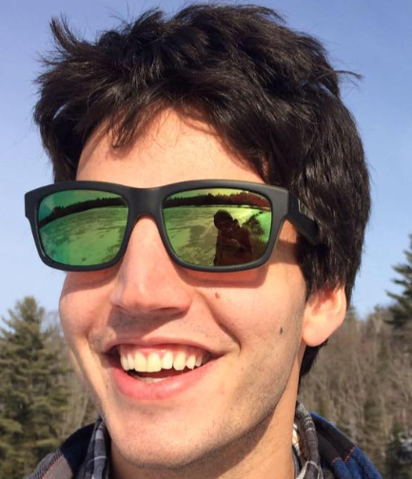
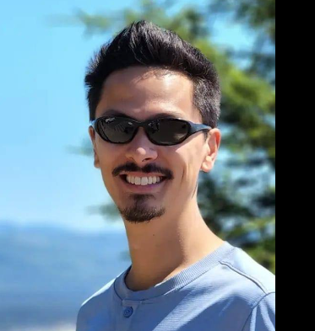
Our Board
Aaron Day
Darius Long
Rob Knight
Isaac Robison
Avery Mornis
Jim Lyall
Tim Banker
Mike Andersen
Matty Pronovost
Erik Schutz

Slide 4
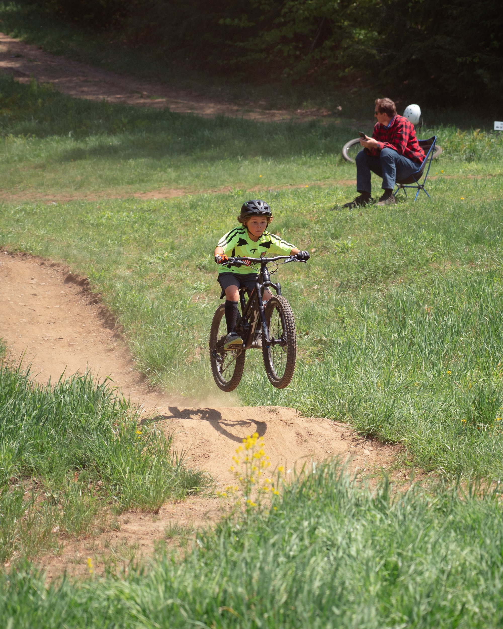
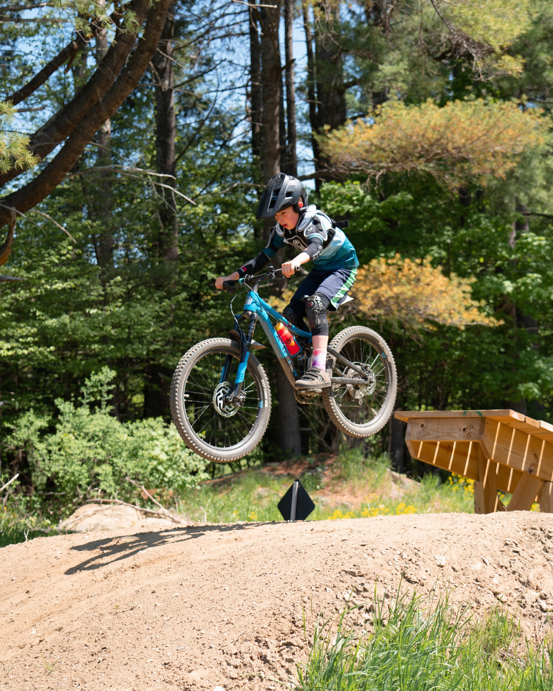
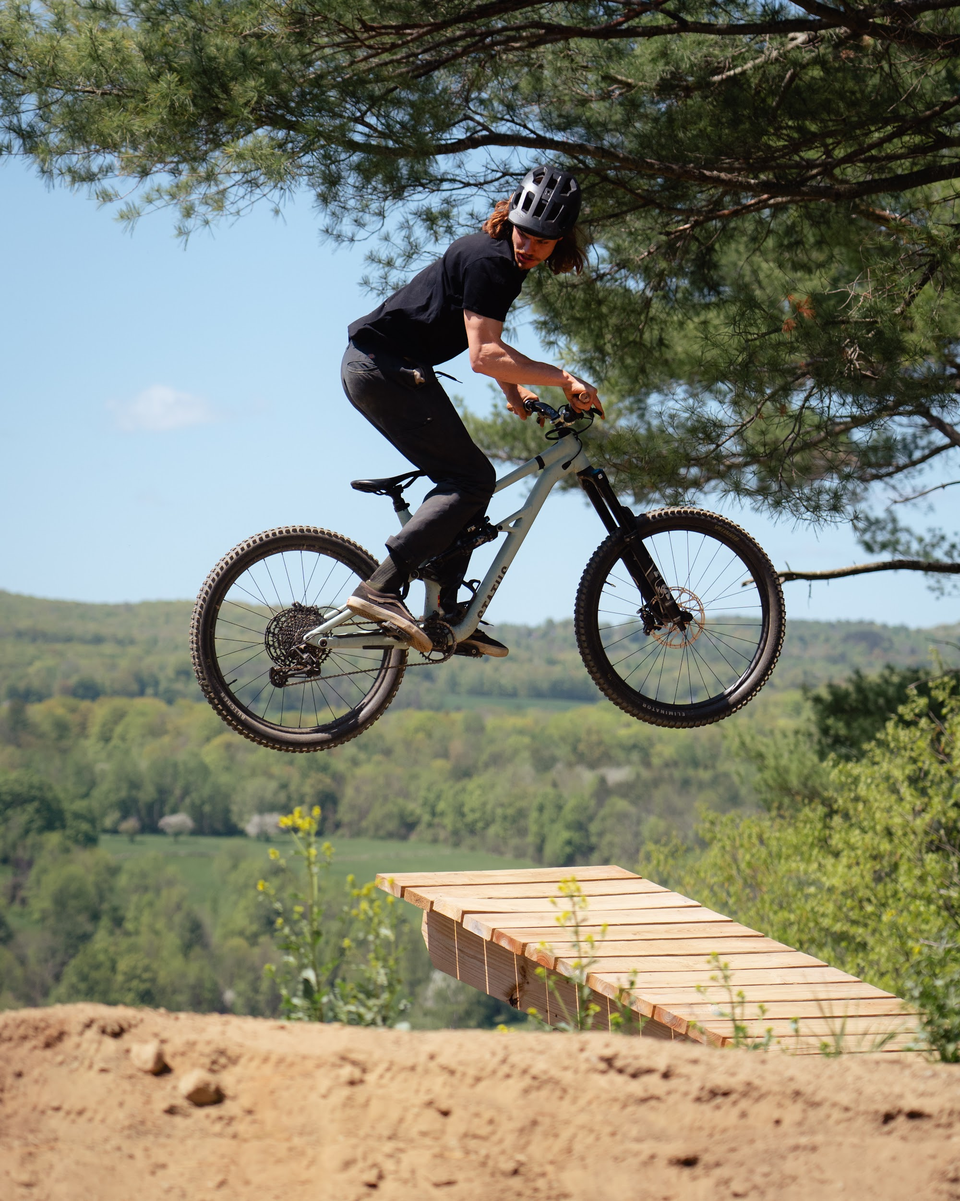
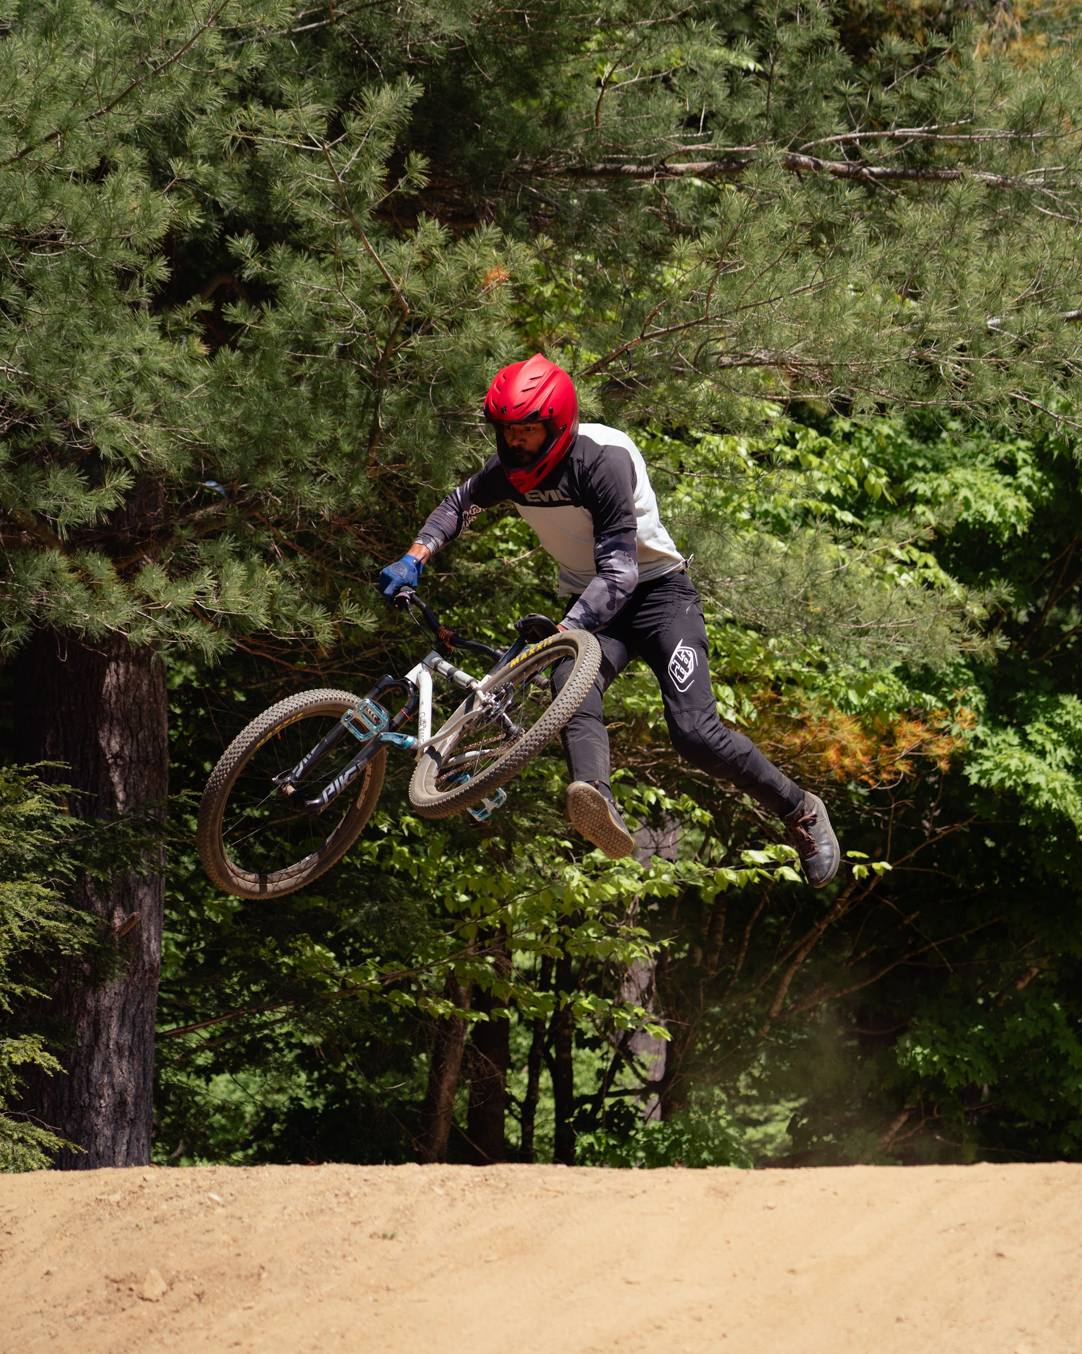
Flow Trail/Park/Pump Track
Aaron Day & Matty Pronovost
Andrew Goulet Skills Park
Flow Trails
Kickstands up! - GLOW
Points East - Points East Acupuncture
VT Overland
Brownsville Butcher and Pantry
Windsor Pump Track/New Rec Area

Slide 5
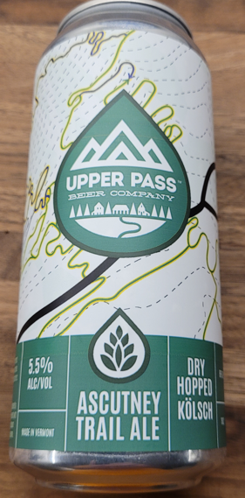
Trails Updates
Darius Long
Community Partnerships: Ascutney Trail Ale :)
Off-mountain Re-openings: 2022 - Split Rock; 2023 - Hurricane Hill!
THANK YOU to off-mountain & on-mountain volunteers
Co-chairing Summer Trails Comm. w/Mike Andersen
Trail Reporting/Admin/Logistics
Trails@ascutneytrails.com

Slide 6
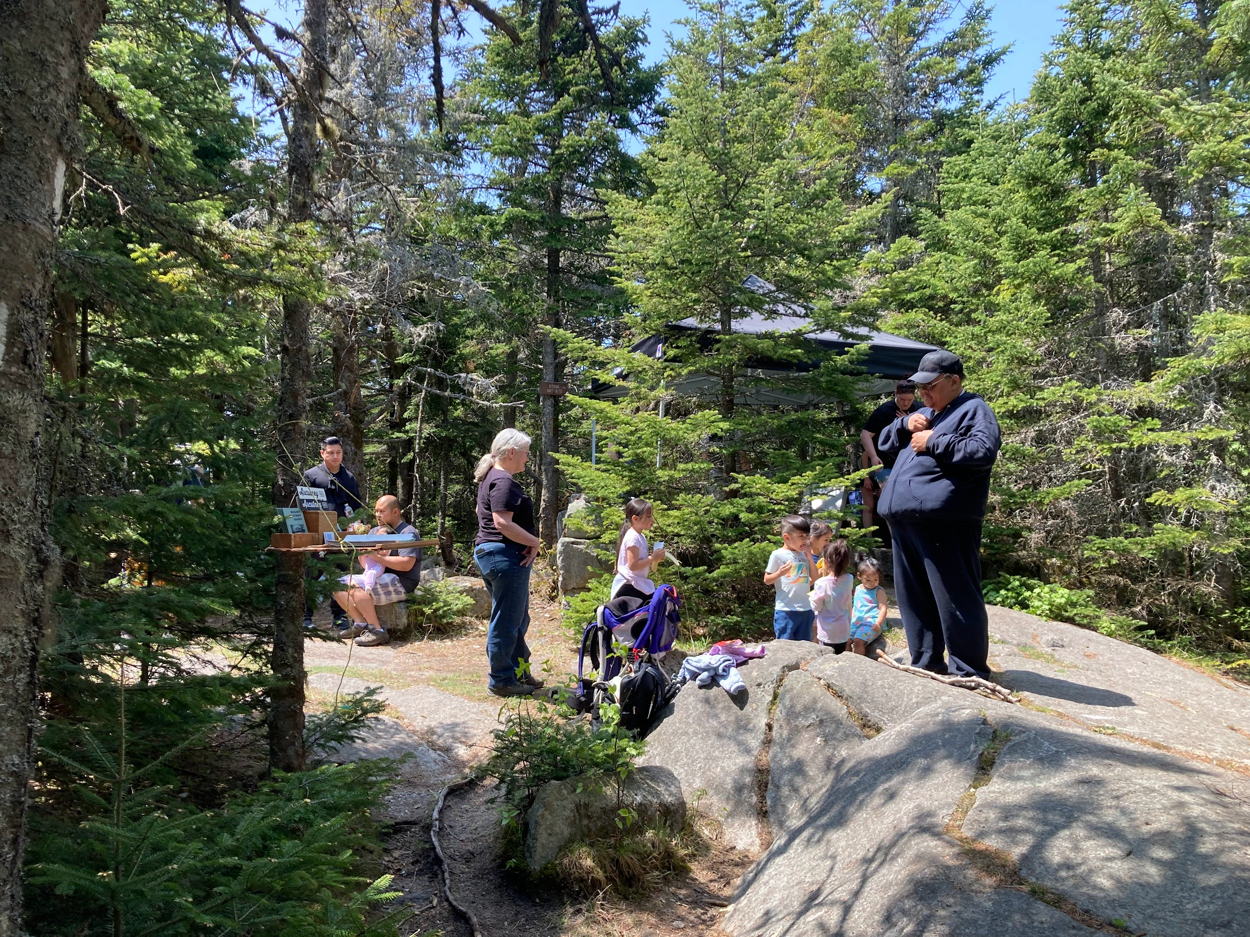
Hiking Activities & Event Reviews
Rob Knight & Isaac Robison
6 Summit trails - volunteer opportunities
Brownsville Trail
Windsor Trail
Cascade Falls (Weathersfield Trail)
Futures Trail - Ascutney State Park
Bicentennial Trail - Town of WW Conservation Commission
AO Trail - Ascutney Outdoors
Game of Logging - Chainsaw Safety Class
Ascutney Day
X people signed in
Approximately $300 in donations
Half sandwiches, chips and cookies, 4 gallons of water and ATA Tent - hiked up to the stone hut site

Slide 7
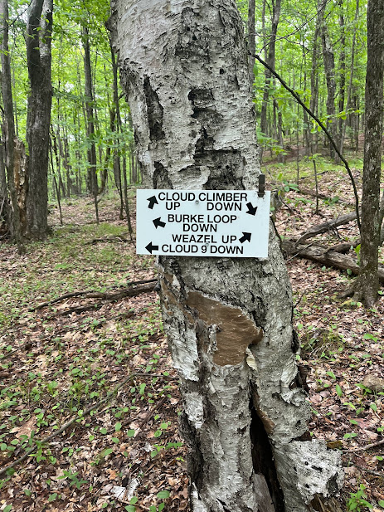
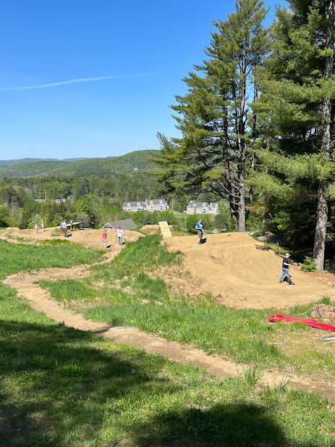
Planned Trailwork & Signage
Avery Mornis & Jim Lyall
Planned Trail Work
Adaptive upgrades @ Cloudspin & Swoops
Upgrades to Lynx, Falls from Grace, & Sluice
Climbing Trail to upper flow trails
Re-integrate old trails west of MLF
Signage and map upgrades
Maintenance and system sustainability

Slide 8
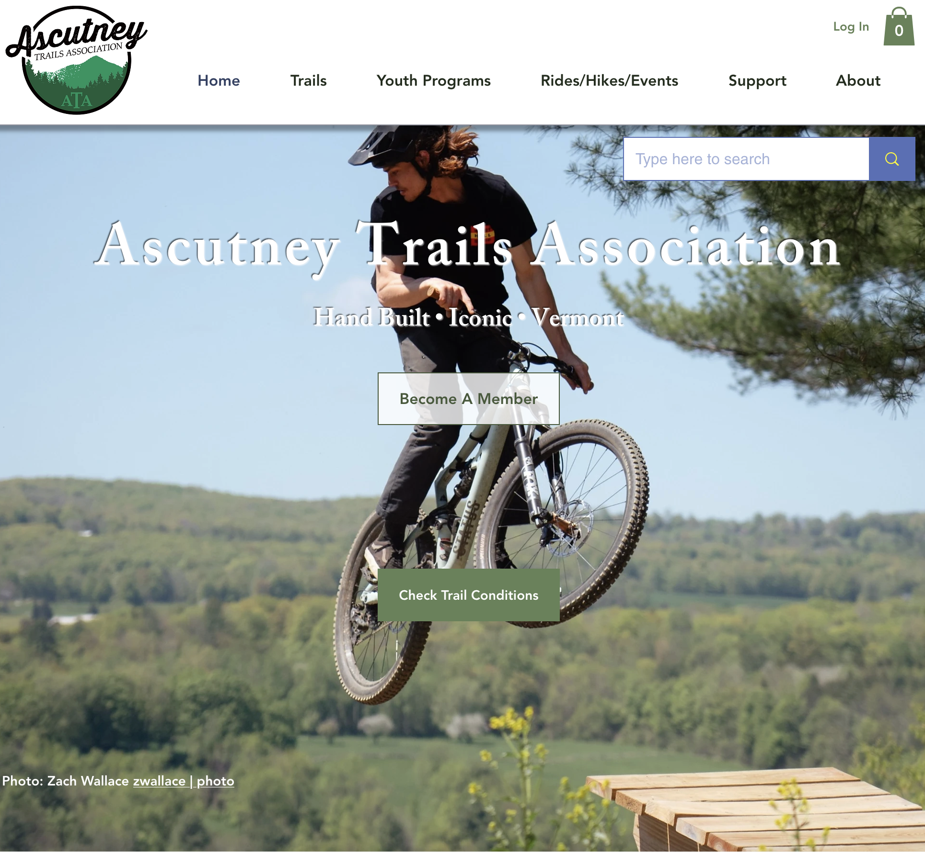
Operations - Website/Communications
Tim Banker & Jim Congdon
Improving operational items and improving how we communicate updates:
New email provider (EmailOctopus)
Wix website host is now charging extra subscription costs for marketing
Auto email from TNR & ThNR blog
Capturing volunteer hours
Signing up for events
Up-to-date calendar of events
Evaluating lower cost or easier to use solutions
Potentially migrating to another website solution, payment provider, etc.
Taking down the merch
Swapping out how we collect payments

Slide 9
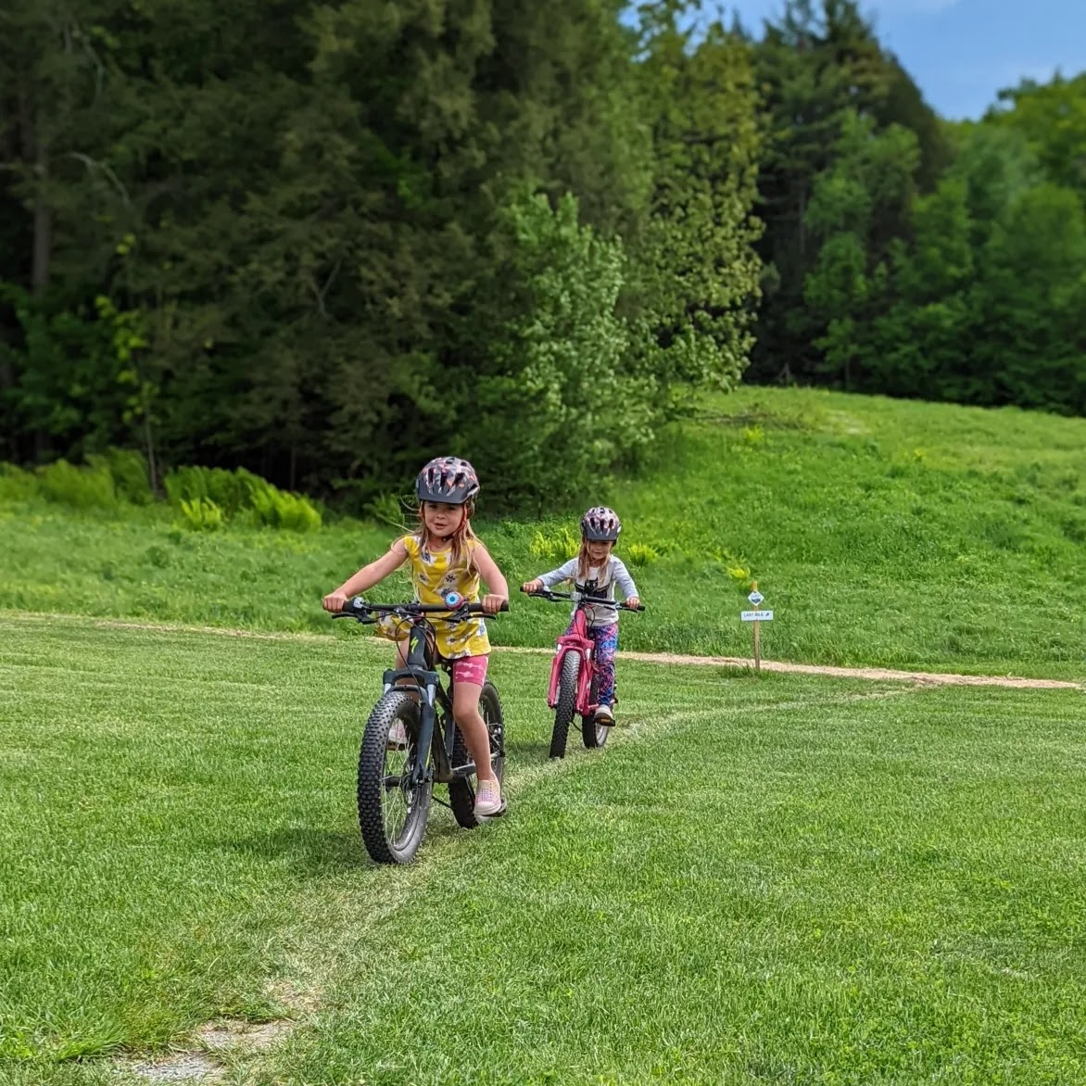
Youth Group 2023
John Brodie
Starting Sunday, June 11th at 3pm
Will follow a multiple “session” format
First 3 weeks up to July 4th Holiday
Second late Summer
Third for the Fall
We will need volunteers to help lead rides, and will ask people to sign up just so we have an idea on attendees
Contact: youth@ascutneytrails.com
Will again ride in West Windsor 4th of July Parade
Kids (and parents) decorate their bikes to ride in the parade

Slide 10
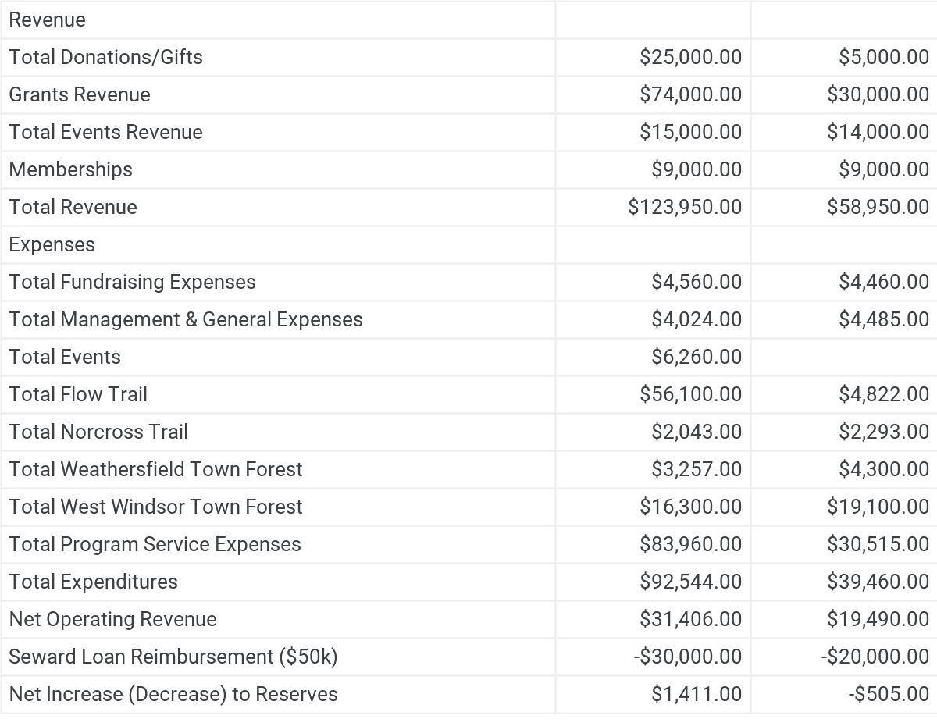
Treasurer’s Report/Budget Review
July 1 - June 30
FY2023
FY2024
As of today

Slide 11
Memberships Recap & Volunteer Hours
Erik Schutz
 | 2019 ATA Memberships | 2020 ATA Memberships | 2021 ATA Memberships | 2022 ATA Memberships
New | 99 | 79 | 63 | 44
Returning | 77 | 124 | 187 | 180
Total | 176 | 203 | 250 | 224
 | 2020 | 2021 | 2022
Volunteer Hours | 994 hours | 1302 hours | X hours

Slide 12
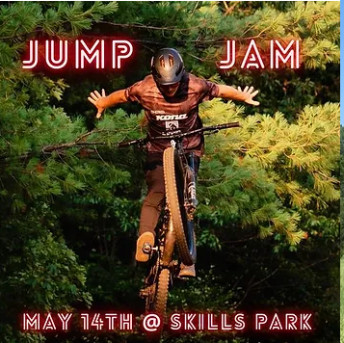
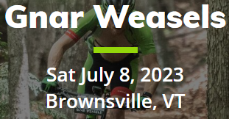
Events on Ascutney Mountain
Erik Schutz
Vermont 50 - Bicycle and Running Race
Vermont Overland - Maple Run and Overland Gravel Ride
Ragnar - 24 hour relay trail run
Gnar Weasels - Mountain Bike Race
Bicycle Race to Summit
Flow State Mountain Bike Festival
ATA Jump Jam
Ascutney Day - Summit Celebration

Slide 13
ATA Trail Management Stats
Erik Schutz
6
Base to Summit Hiking Trails
Windsor Trail
Weathersfield Trail
Brownsville Trail
Bicentennial Trail
Futures Trail
AO Trail
45 miles
Public land trails “mapped”
35 miles
Private land trails “unmapped”
$1M
Worth of trail infrastructure on public land
$50k
Future planned projects

Slide 14
Partner Trail Organization (Upper Valley)
Erik Schutz
(UVMBA) Upper Valley Mountain Bike Association - VMBA Chapter
(WAMBA) Woodstock Area Mountain Bike Association - VMBA Chapter
(UVTA) Upper Valley Trails Alliance - Norwich, VT
Norwich Trails - Norwich, VT
Trescott Land - Hanover, NH
(ATA) Ascutney Trails Association - VMBA Chapter

Slide 15
Board of Director Openings
Erik Schutz
Two Board of Director openings to fill this year
If you are someone good with numbers, detail oriented (think treasurer) or sales/marketing knowledge/experience we’d love to have you join us
Communications & Social Media
Fundraising & Sponsorships
Board diversity is important
Nominations & voting!
Aaron Day nominated Mike Andersen and Tim Banker for re-election. Matt Pronovost seconded
Erik Schutz nominated Granzia Gaudencja, Mike Andersen seconded
Rob Knight nominated Wendi Reuter-Lorenz, Jim Lyall seconded.
ATA members unanimously approved the nominations and Granzia, Wendi, Tim and Mike start their 2 year terms as ATA board members.

Slide 16
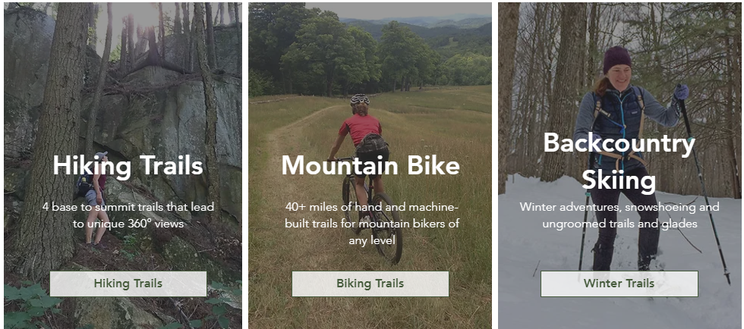
Thank you ATA Members! Enjoy Ascutney!

